Slide 1
BERMUDA’S HEALTH SYSTEM: Town Hall Meeting with the Health Council
Facilitator:
Mr. Kevin Monkman
Panelists:
Dr. Ricky Brathwaite, Programme Manager, Health Economics
Mr. Ian Cameron, Policy Analyst / Compliance Officer
Mrs. Laure Marshall, Programme Manager, Health Regulation
Presented on: 22nd August 2016
Presented at: Wesley Methodist Church Hall

Slide 2
Overview:
5:30 – 5:55 p.m. Welcome, Introductions, Opening Remarks
5:55 – 6:55 p.m. Public Discussion
7:00 – 7:25 p.m. Light Refreshments and Conversations

Slide 3
About Bermuda Health Council
Quasi-Autonomous Non-Governmental Organisation (QUANGO)
Established by Bermuda Health Council Act 2004. Operational since 2006.
Mission: To regulate, coordinate, and enhance the delivery of health services
Vision: Achieving a quality, equitable and sustainable health system
Structure:
Board - 15 members
Secretariat - 9 staff

Slide 4
What we do

Slide 5
Health Insurance Coverage - SHB
SUPPLEMENTAL BENEFITS
Private Insurers
(& Approved Schemes)
$450 - $1,700
Future Care
$504.21
HIP
$433.31
Services covered
HOSPITALIZATION AND HOSPITAL RELATED SERVICES
Standard Health Benefit $338.07
(& Mutual Reinsurance Fund)
Proportion of costs covered
Adapted from
WHO 2010
Population covered

Slide 6
Total Health Expenditure

Slide 7
Employers’ Compliance

Slide 8
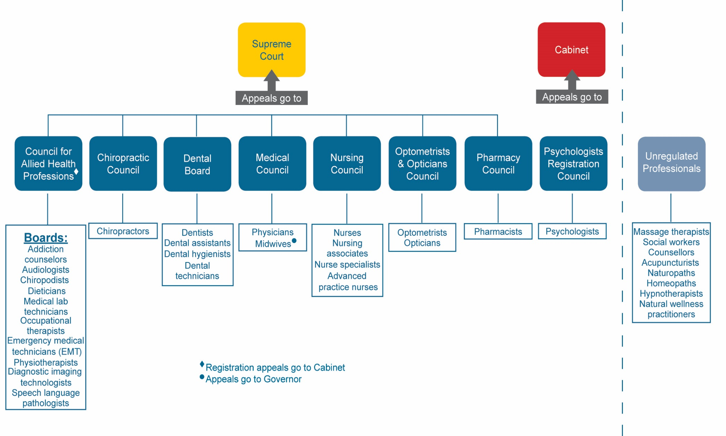
Health Professionals

Slide 9
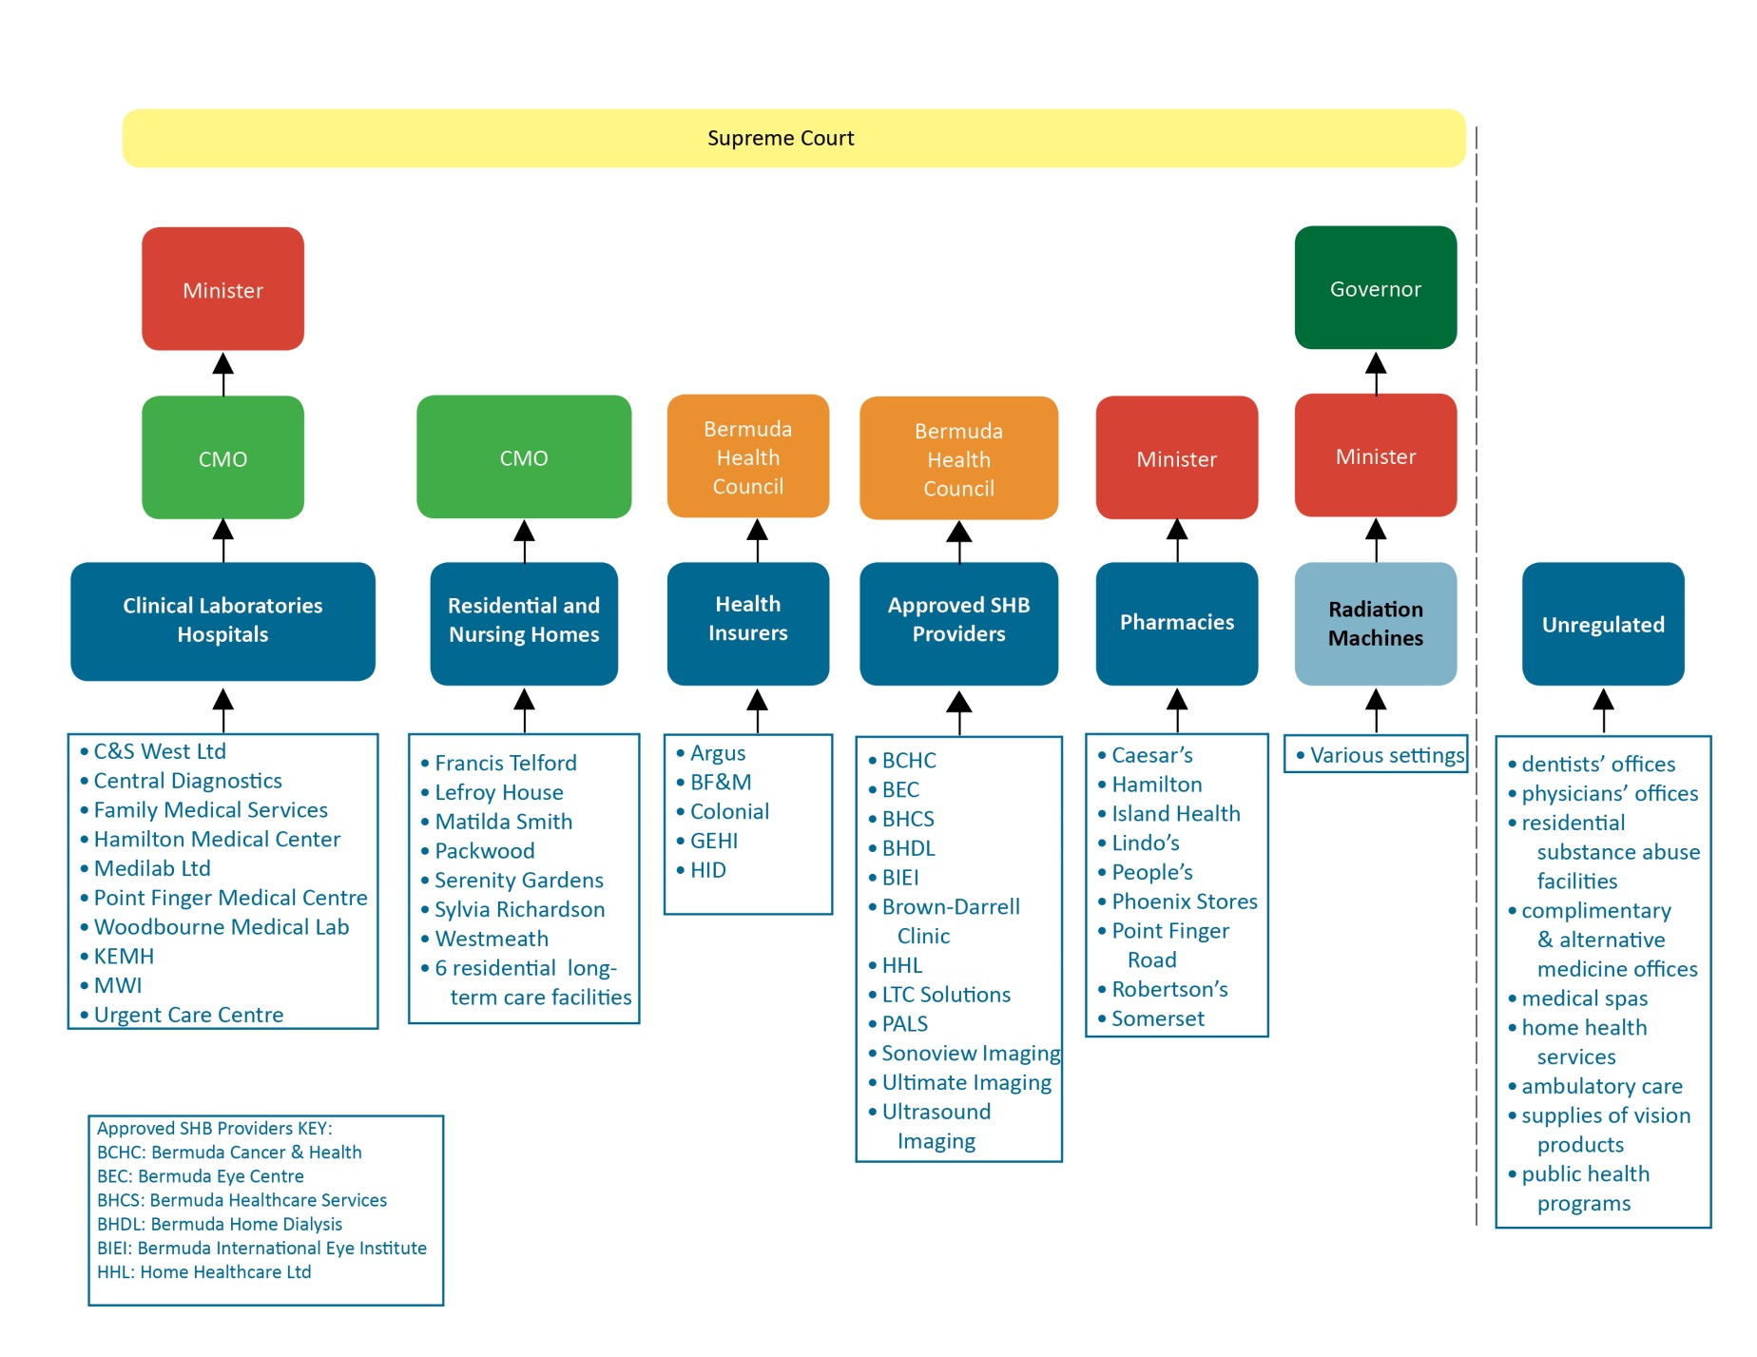
Health Service Providers

Slide 10
Ageing population

Slide 11
Discussion Questions and Comments? Contact us! healthcouncil@bhec.bm 292-6420

